Slide 2

Senior Manager & Digital Innovator of EY Italy
Co-Founder of ItaliaDotNet Community
Microsoft MVP AI
Intel Innovator Program
Co-Founder of Fifth Ingenium
About Me
https://www.linkedin.com/in/antimo-musone/
Contacts
https://twitter.com/AntimoMusone
antimo.musone@hotmail.com/antimo.musone@it.ey.com

Slide 3

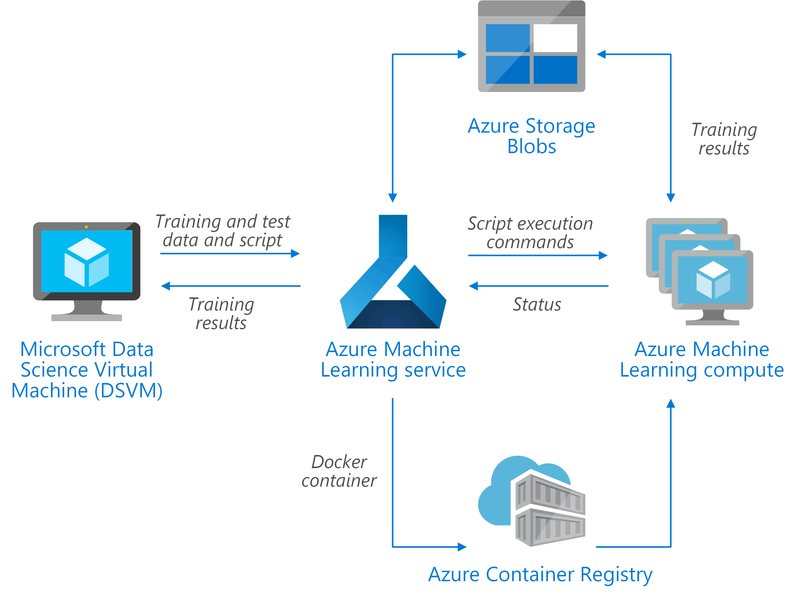
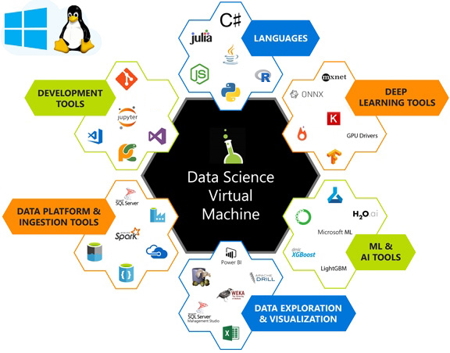
ML : Starting with Jupyter
Project Jupyter exists to develop open-source software, open-standards, and services for interactive computing across dozens of programming languages. Allows you to create and share documents that contain live code, equations, visualizations and narrative text and it is powered by Microsoft Azure.
Do quick experiments with Julia, Python, R (from here the name Jupyter), C++, Ruby, Go, Java, C# ,F# and more
Mix live code and documentation, both formatted with Markdown and syntax highlighting
Visualize data inside the notebook or can be be exported/shared as results
Scale up your Jupyter Notebook on Azure Machine Learning Service or DVSM

Slide 4

Interactive Computing
“The immediate exchange of input and output between a computer and the user”.
Provides a rich architecture for interactive computing with:
A Powerful interactive shell.
A Kernel for Jupyter.
Support for interactive data visualization and use of GUI toolkits.
Flexible, embeddable interpreters to load into your own projects.
Easy to use, high performance tools for parallel computing.
IPython 3.x was the monolithic release of IPython, containing the notebook server, qtconsole, etc.
IPython 4.0 is the language-agnostic parts of the project, the notebook format, message protocol, qtconsole, notebook web application, etc. have moved to new projects under the name Jupyter

Slide 5
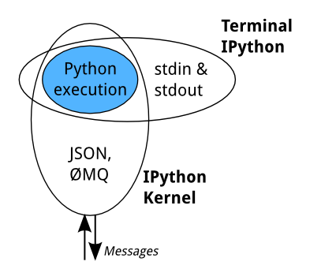
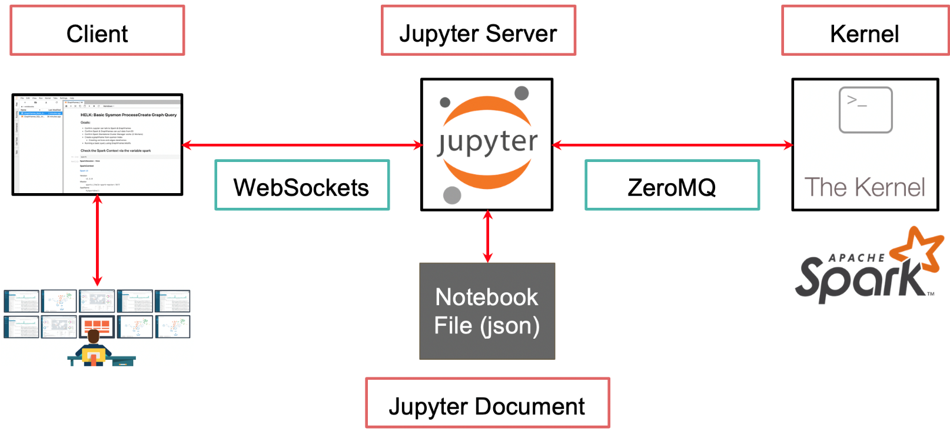
Jupyter Architecture
Highline Architecture
Kernel
https://github.com/jupyter/jupyter/wiki/Jupyter-kernels

Slide 6
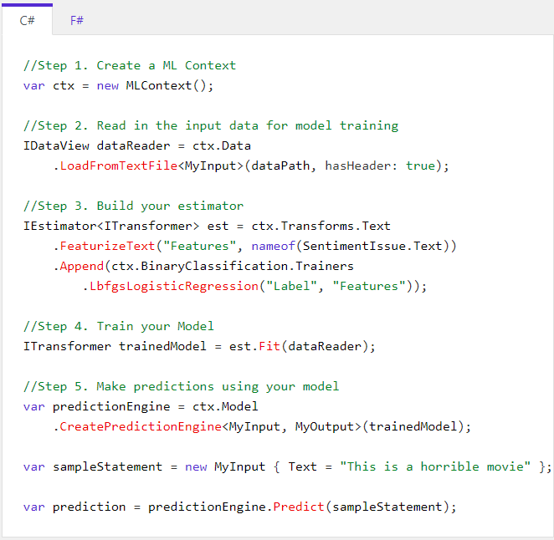
ML.NET
An open source and cross-platform machine learning framework
Built for .NET developers, you can create custom ML models using C# or F# without having to leave the .NET ecosystem.
ML.NET offers AutoML and productive tools to help you easily build, train, and deploy high-quality custom ML models.
ML.NET has been designed as an extensible platform so that you can consume other popular ML frameworks (TensorFlow, ONNX, Infer.NET, and more) and have access to even more machine learning scenarios, like image classification, object detection, and more.

Slide 7
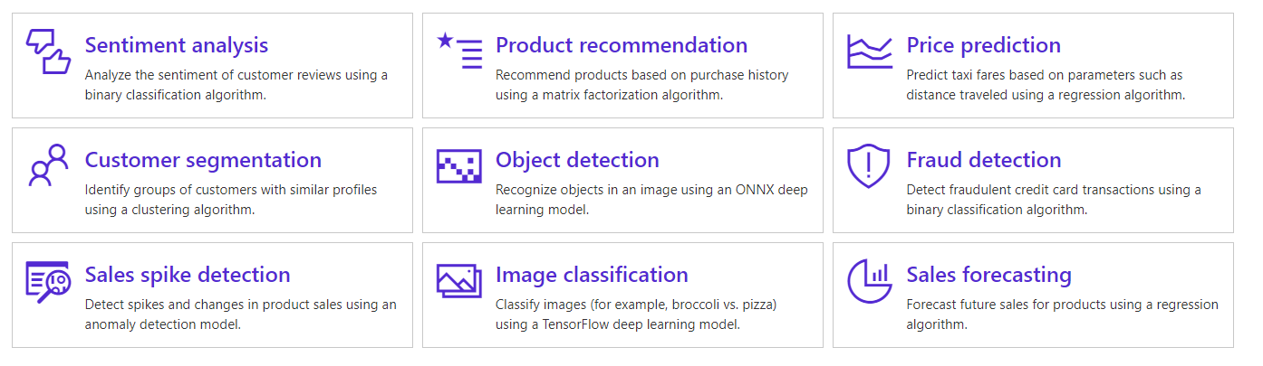
ML.NET

Slide 8
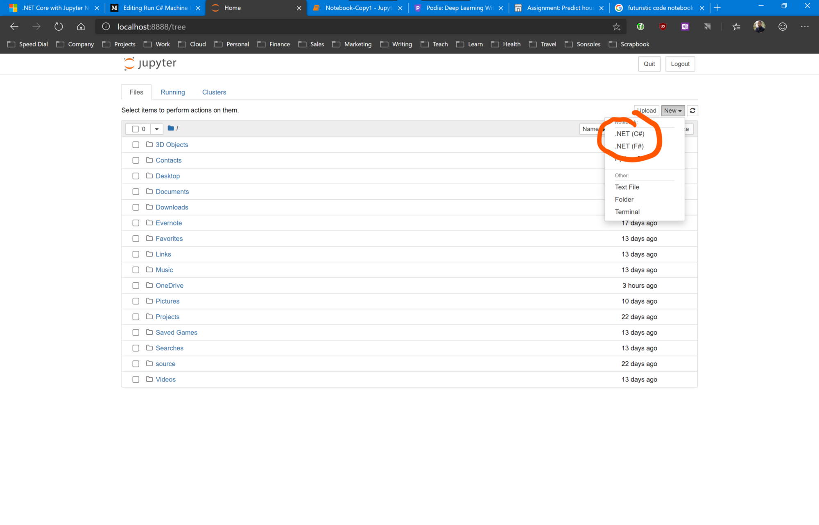
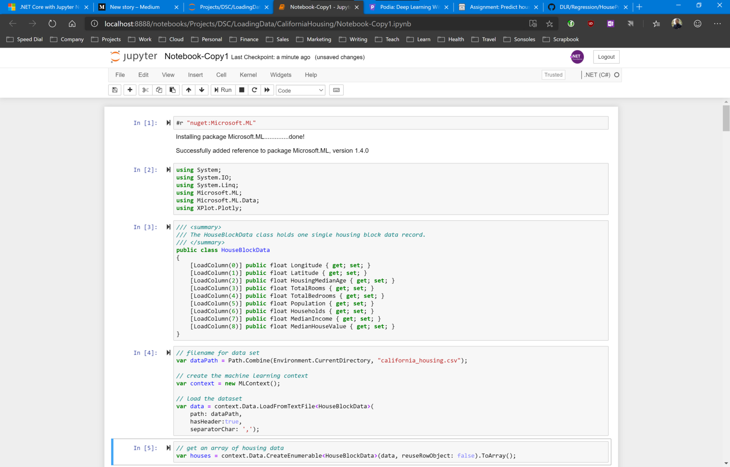
C# - .Net Notebook- Preview 1 – November 2019
> Install .Net Core 3.0 SDK
> Install anaconda3
> dotnet tool install -g dotnet-try
> dotnet try jupyter install
https://devblogs.microsoft.com/dotnet/net-core-with-juypter-notebooks-is-here-preview-1/

Slide 9
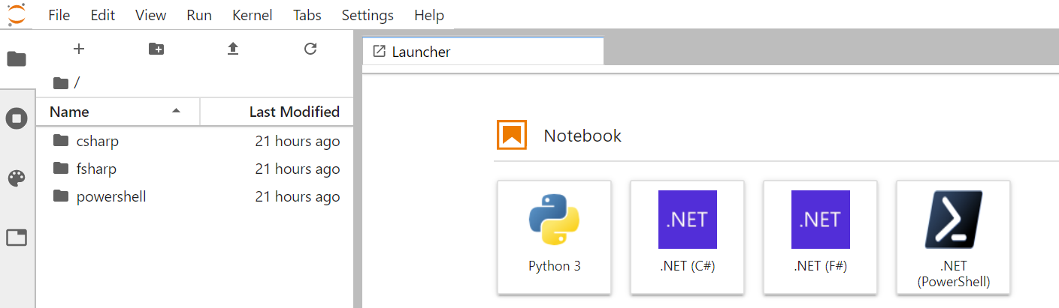
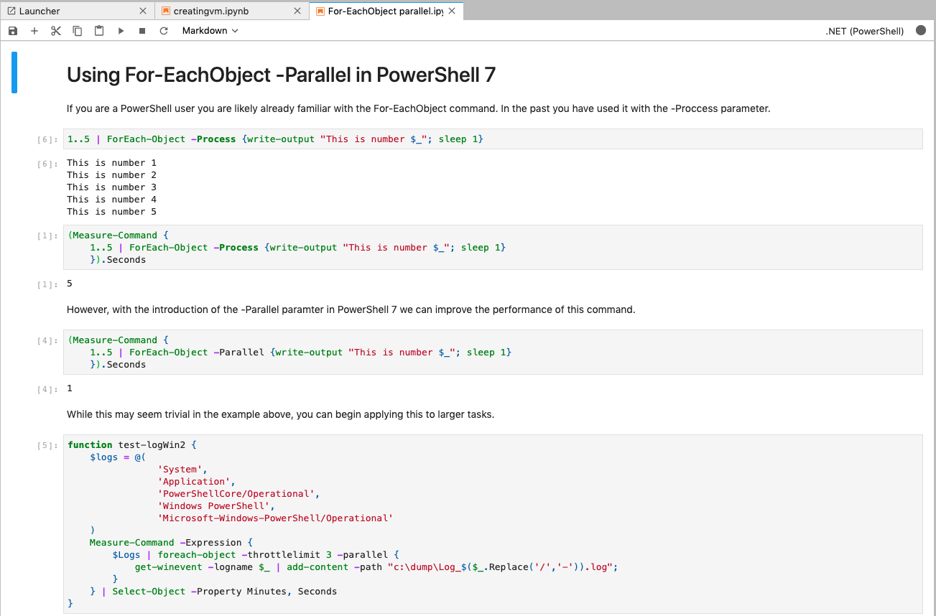
C# - .Net Notebook – Preview 2 – February 2020
> Install .Net Core 3.1 SDK
> Install anaconda3
>dotnet tool install
--global Microsoft.dotnet-interactive
> dotnet interactive jupyter install
https://devblogs.microsoft.com/dotnet/net-interactive-is-here-net-notebooks-preview-2/

Slide 10
Try Jupyter for Free
https://mybinder.org/
https://notebooks.azure.com/
https://colab.research.google.com/
https://www.kaggle.com/notebooks

Slide 11

Data Science
Experimentation?

Slide 12
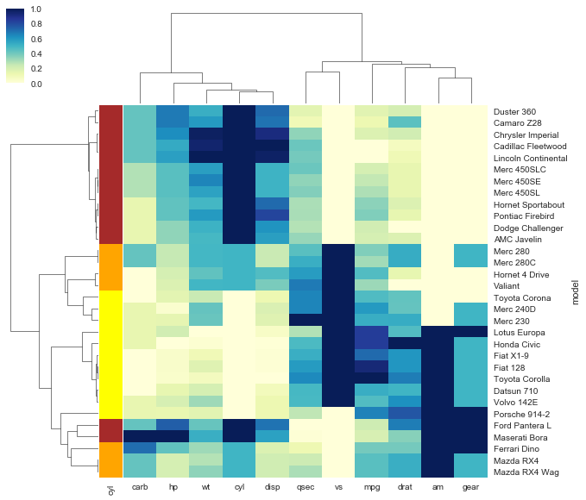
Heatmap

Slide 13
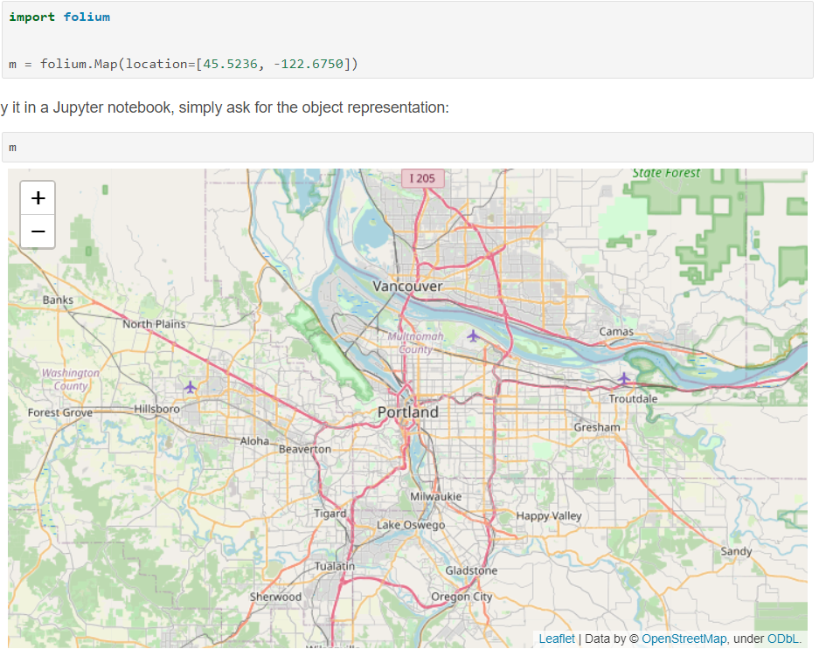
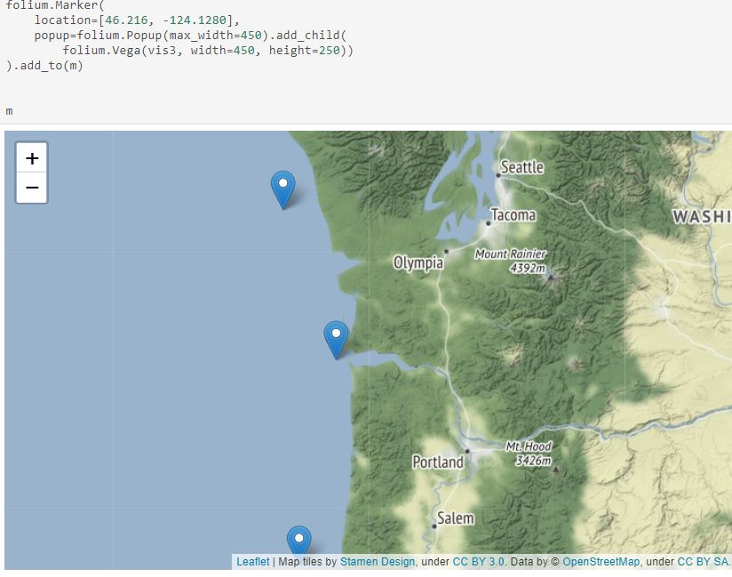
Folium
To create a base map, simply pass your starting coordinates to Folium:
https://python-visualization.github.io/folium/

Slide 14
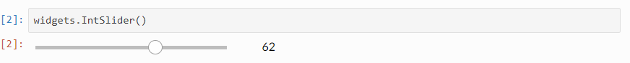
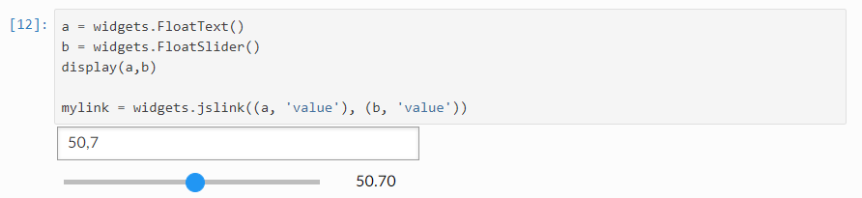
ipywidgets
Widgets are eventful python objects that have a representation in the browser, often as a control like a slider, textbox, etc.
https://ipywidgets.readthedocs.io/en/latest/index.html

Slide 15

Voila
Voilà turns Jupyter notebooks into standalone web applications. Unlike the usual HTML-converted notebooks, each user connecting to the Voilà tornado application gets a dedicated Jupyter kernel which can execute the callbacks to changes in Jupyter interactive widgets.
https://voila.readthedocs.io/en/stable/
https://voila-gallery.org/

Slide 16
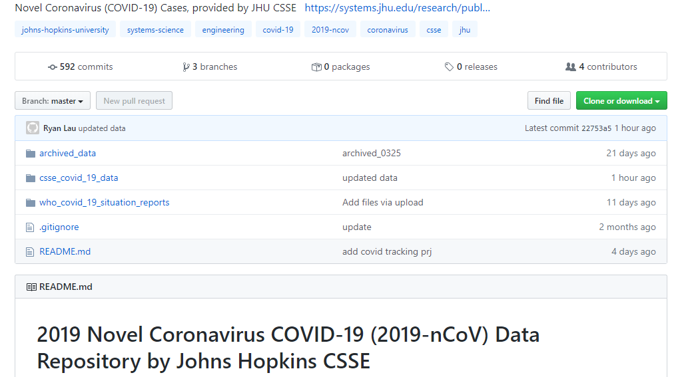
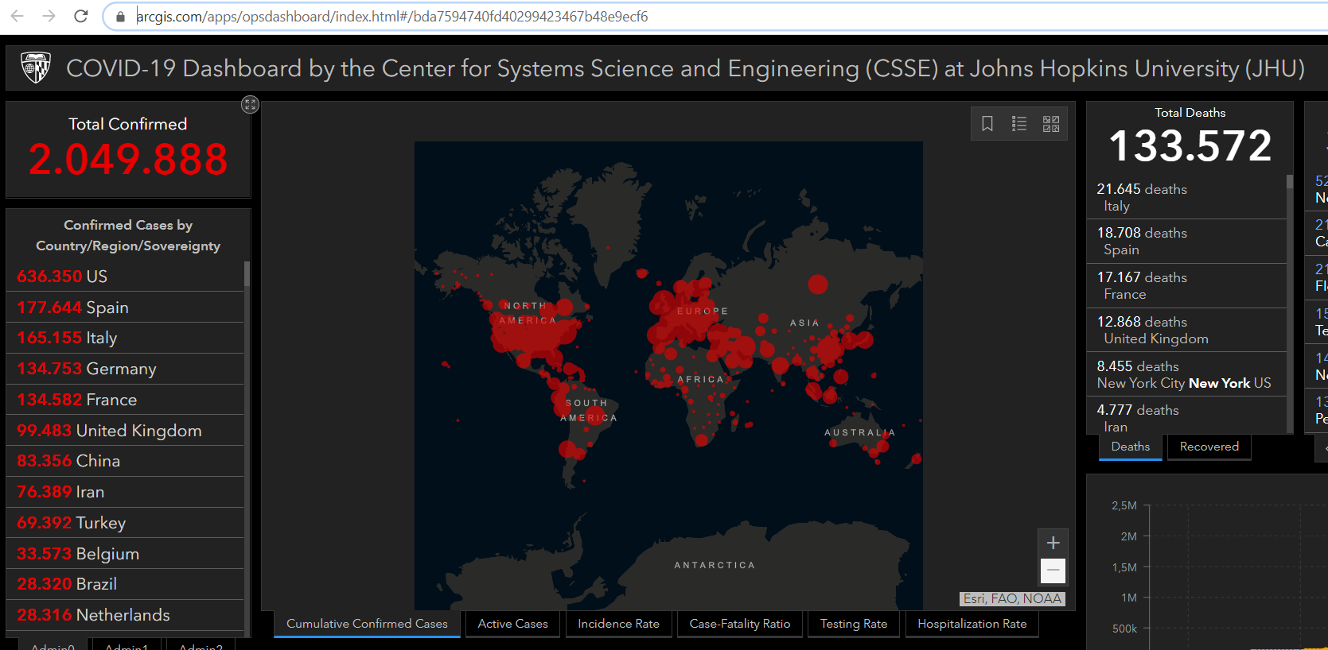
Dataset COVID 19
Data repository is Novel Coronavirus (COVID-19) operated by the Johns Hopkins University Center for Systems Science and Engineering, open and available on Github.
https://github.com/CSSEGISandData/COVID-19
Sample Dashboard based on Data repository
https://www.arcgis.com/apps/opsdashboard/index.html#/bda7594740fd40299423467b48e9ecf6

Slide 17
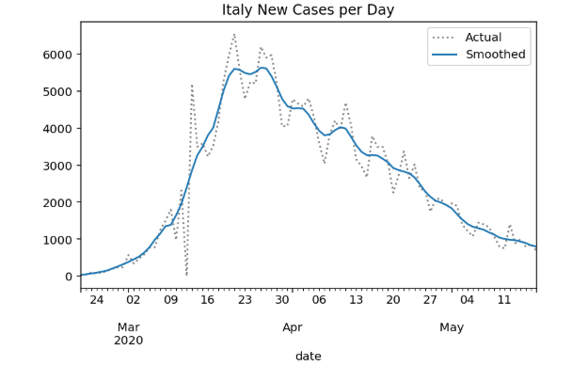
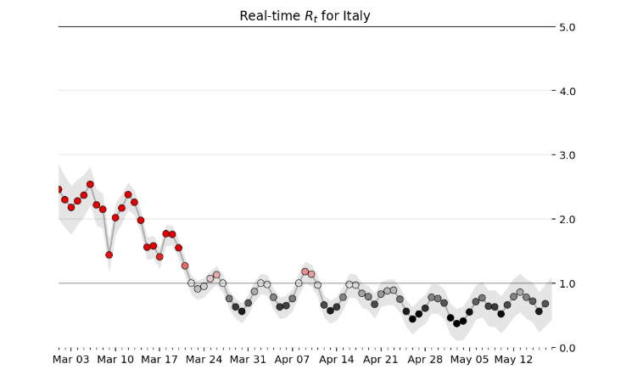
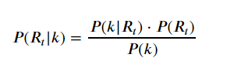
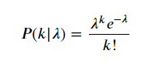
Metrics to Manage COVID-19
Rt: the effective reproduction number
R0 is the basic reproduction number of an epidemic. It’s defined as the number of secondary infections produced by a single infection. If R0 is greater than one, the epidemic spreads quickly, If R0 is less than one, epidemic don’t spreads and disappears before everyone becomes infected. While R0 is a useful measure but it’s static so because the Epidemy changes so rapidly the only true way to combat COVID19 is to understand and manage by Rt.
Bettencourt & Ribeiro's Approach
Described in the paper, “Real Time Bayesian Estimation of the Epidemic Potential of Emerging Infectious Diseases.”
This is Bayes' Theorem :
This is Poisson Distribution

Slide 18
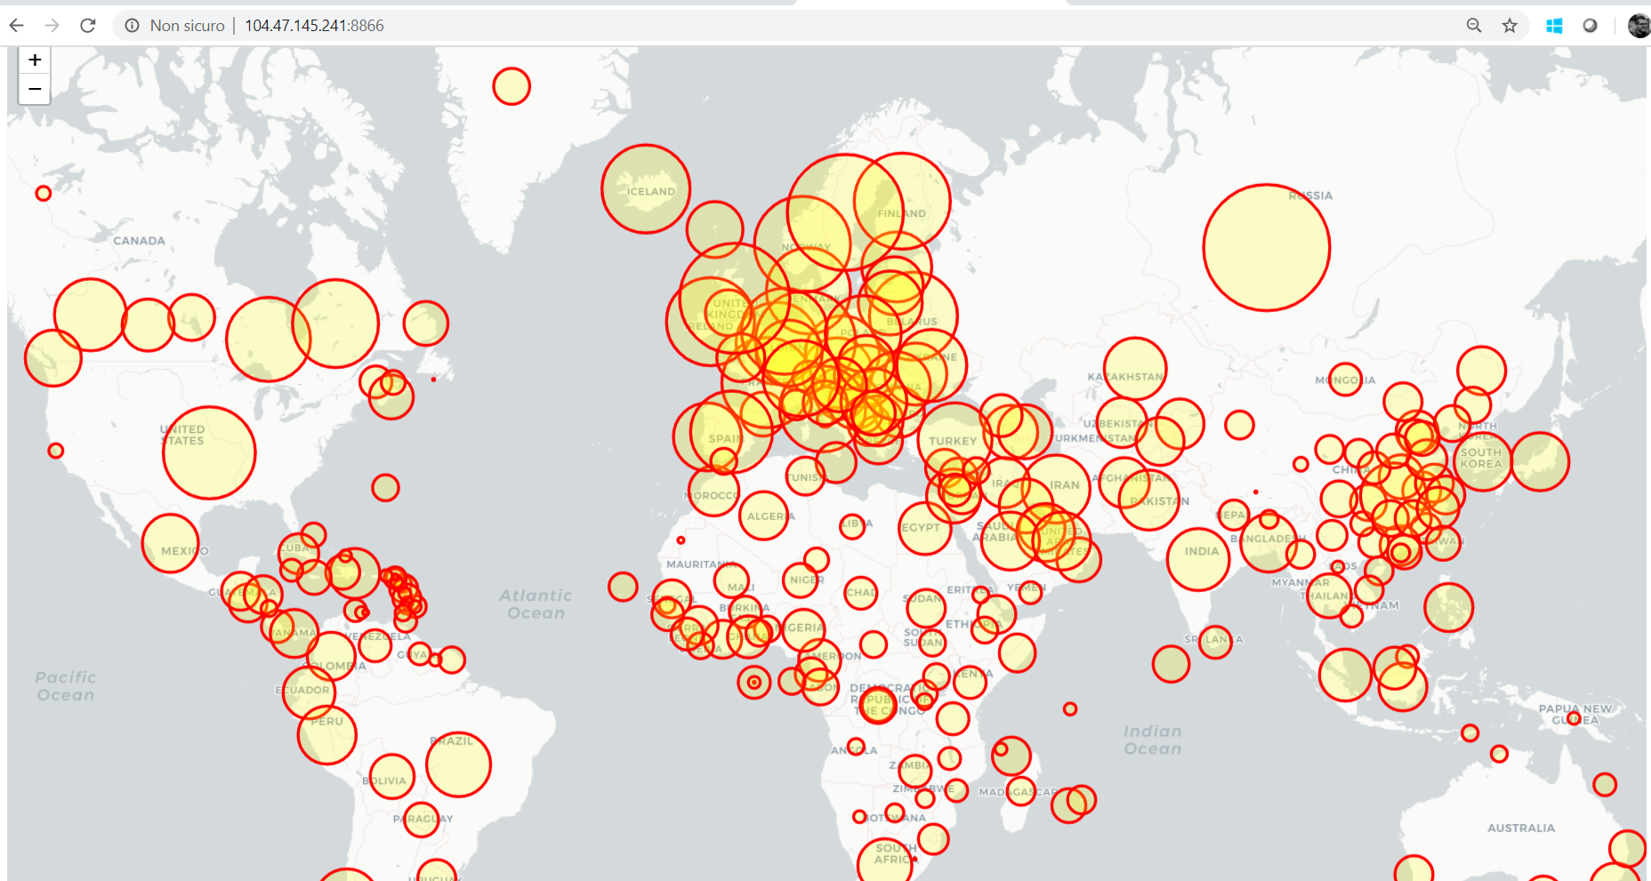
https://bit.ly/build2020-covid

Slide 19
DEMO – DASHBOARD COVID

Slide 20
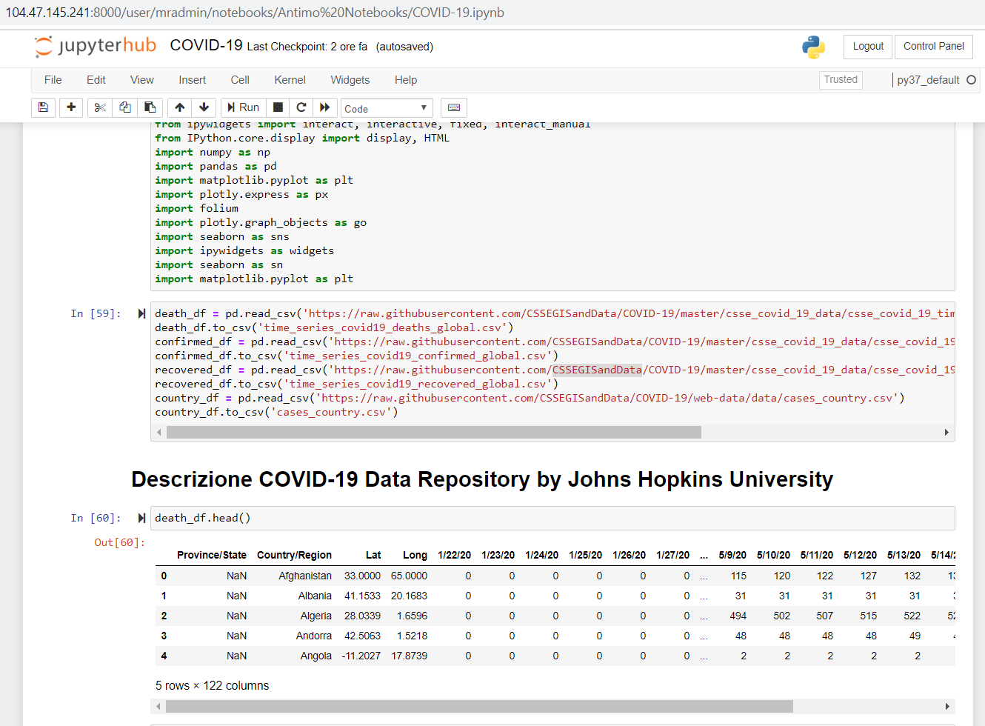
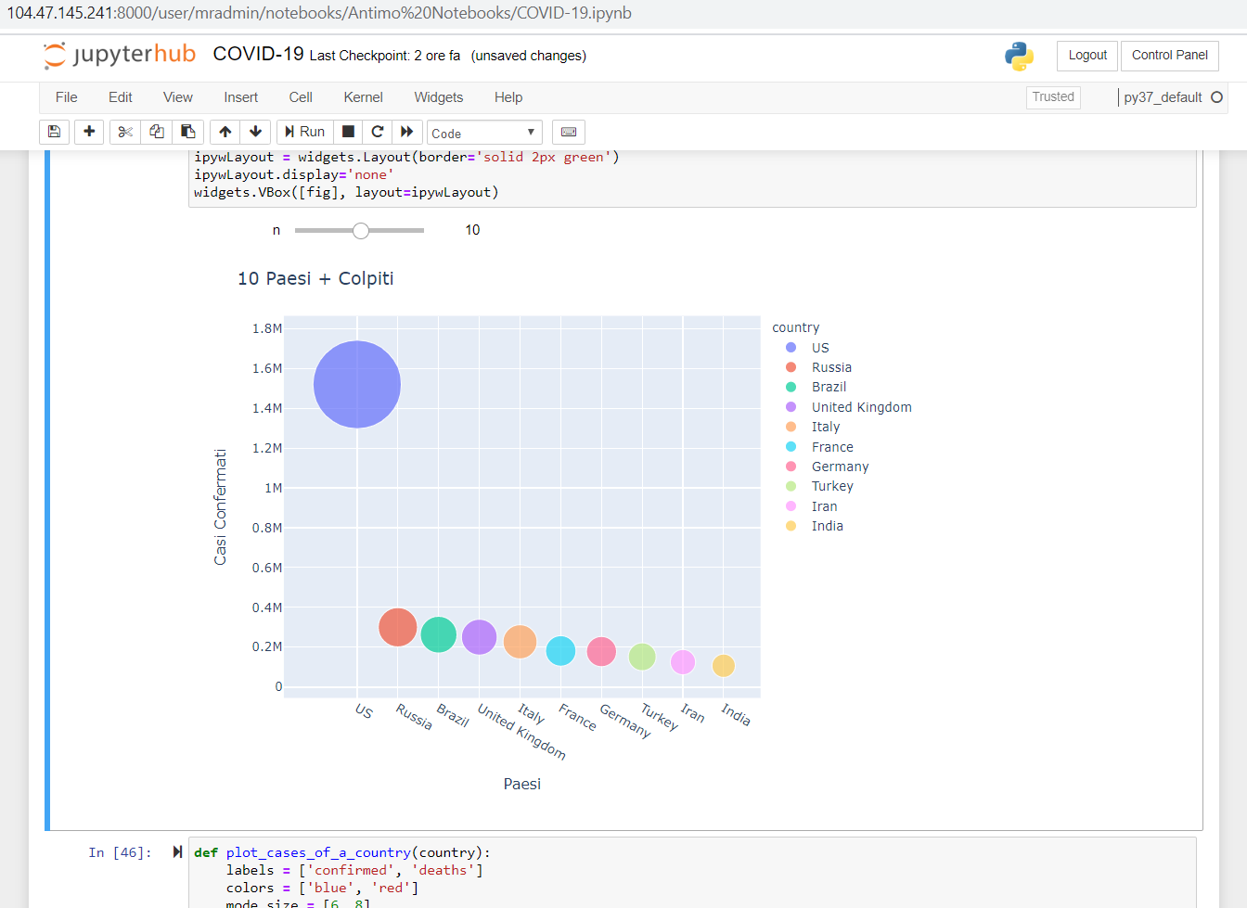
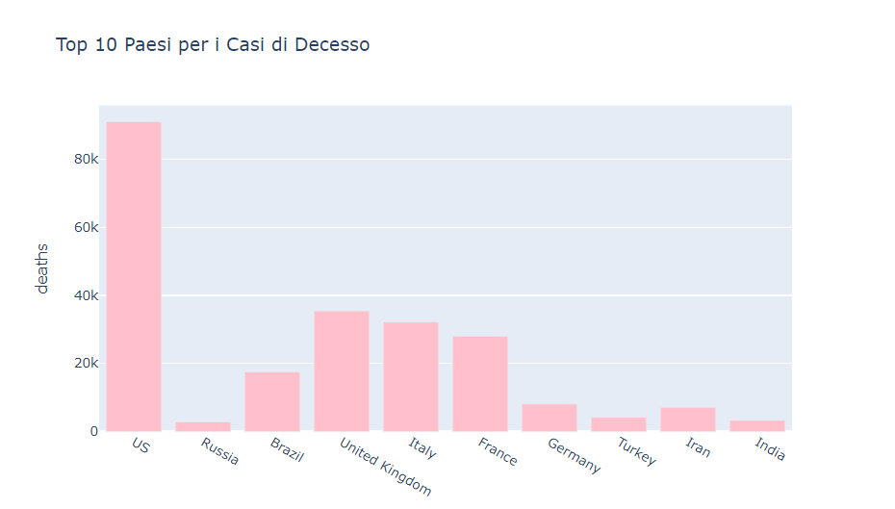
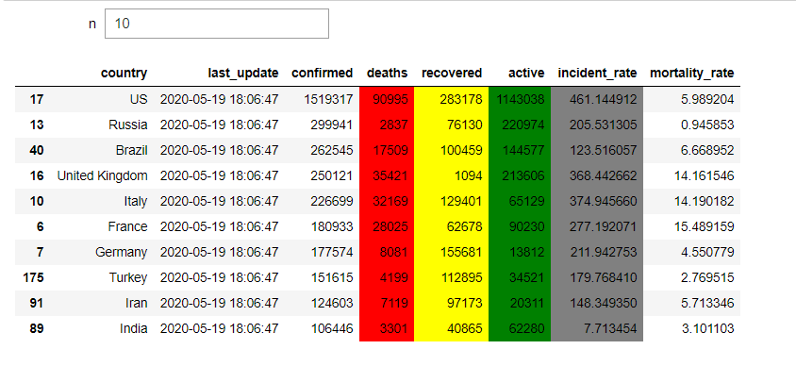

Slide 21
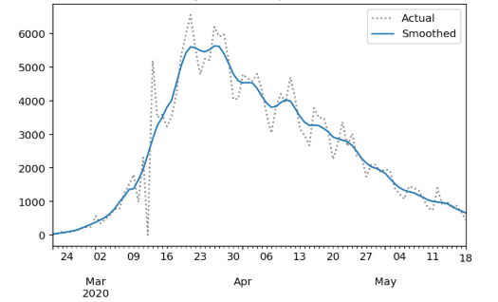
Contagion Trend- Italy

Slide 22
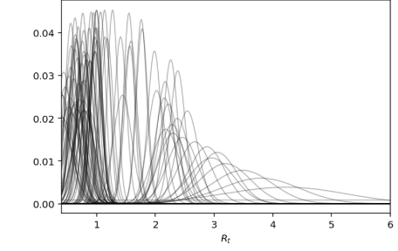
Probability Trend of Rt value – 7 Days

Slide 23
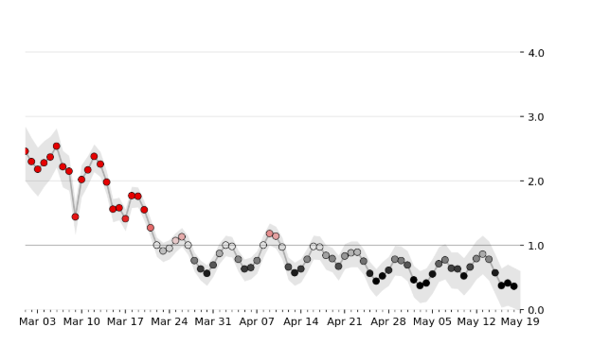
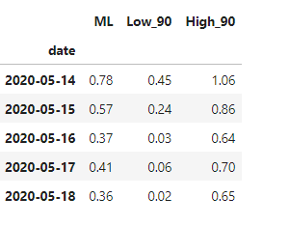
Rt Trend with Highest-Density-Interval – 19 May
Highest-Density-Interval
Rt

Slide 24
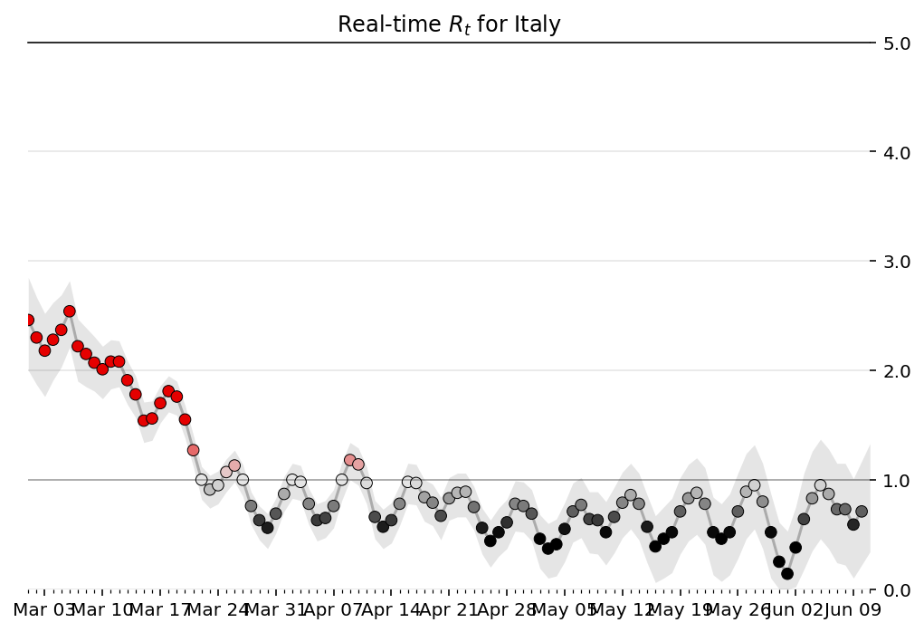
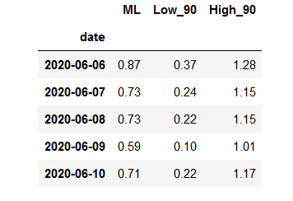
Rt Trend with Highest-Density-Interval – 11 June
Rt
Highest-Density-Interval

Slide 25
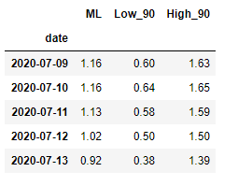
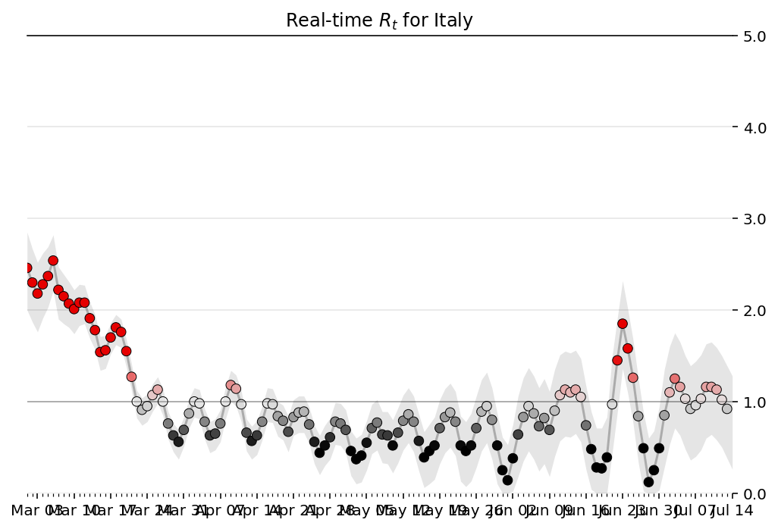
Rt Trend with Highest-Density-Interval – 14 July

Slide 26
DEMO – .NET Nootebook & ML.Net

Slide 27
Part - 1
Part - 2
DataFrame is a new type introduced in .Net. It is similar to DataFrame in Python is used to manipulate data in notebooks. It's a collection of columns containing data similar to a table
Load a CSV
Metadata
- Description
- Info
Display records
- Head
- Sample
Filtering, Grouping,Aggregate
Reports
Applying machine learning for making a prediction using time-series, building a model on the number of confirmed cases and predicting for the next 7 days
Dataset and Transformations
Data Classes Input/Output
ConfirmedData : Provides a map between columns in a dataset
ConfirmedForecast :
Data Analysis
ML Pipeline
Train Model
Prediction/Forecasting
Prediction Visualization
Notes:
DataFrame is a new type introduced in .Net. It is similar to DataFrame in Python which is used to manipulate data in notebooks. It's a collection of columns containing data similar to a table and very helpful in analyzing tabular data.

Slide 28
Question Time

Slide 29
Senior Manager & Digital Innovator of EY Italy
Co-Founder of Fifth Ingenium
Co-Founder of ItaliaDotNet Community
Microsoft MVP AI
Intel Innovator Program
About Me
https://www.linkedin.com/in/antimo-musone/
Contacts
https://twitter.com/AntimoMusone
antimo.musone@hotmail.com/antimo.musone@it.ey.com
+39 345 3636642

Slide 30
Thank You!!!

